Slide 1
Fake News Detection Using ML
Submitted by:
Remanshi Gajera (20BIT018)
Bhavya Mehta (20BIT029)
Vaidehi Patel (20BIT031)
Ayushi Patel (20BIT059)
Priyanka Trivedi (20BIT152D)

Slide 2
Introduction
Part: 1 - AI/Human Generated News Identification
Part: 2 - Fake news Detection

Slide 3
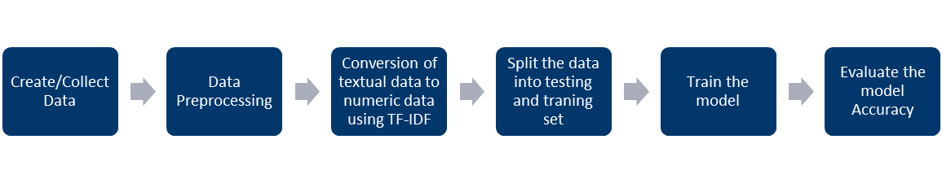
Methodology

Slide 4
Logistic Regression
Statistical method for analyzing a dataset in which there are one or more independent variables that determine an outcome.
As outcome is a probability, the dependent variable is bounded between 0 and 1.

Slide 5
TF-IDF(Term Frequency- Inverse Document Frequency)
Text vectorizer that transforms the text into a usable vector.
TF: measures how often a word appears in a document
IDF: measures how unique a word is across all documents
Result: gives a higher weight to words that are both frequent in a particular document and rare across all documents.

Slide 6
Stemming
The English language has several variants of a single term. The presence of these variances in a text corpus results in data redundancy when developing NLP or machine learning models. Such models may be ineffective.
To build a robust model, it is essential to normalize text by removing repetition and transforming words to their base form through stemming.
In information retrieval, text mining SEOs, Web search results, indexing, tagging systems, and word analysis, stemming is employed. A Google search for prediction and predicted returns comparable results.

Slide 7
Stop Word Removal
Part of Text Pre-Processing
The words which are generally filtered out before processing a natural language are called stop words. These are actually the most common words in any language (like articles, prepositions, pronouns, conjunctions, etc) and does not add much information to the text.
The removal of such words does not show any negative consequences on the model we train for our task.

Slide 8
Part: 1 AI/Human Generated News Identification
Create and Pre-process data
Conversion of textual data to numeric data using TF-IDF
Split the data into testing and training set by ratio of 30:70
Training the model
Evaluate the model accuracy
Use the model to predict new data

Slide 9
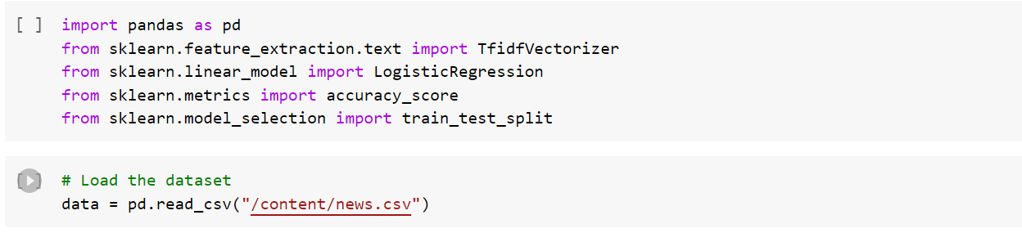
Create and Preprocess Data

Slide 10
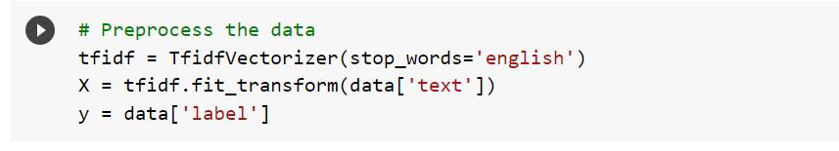
2. Conversion of textual data to numeric data using TF-IDF

Slide 11
3. Split the data into testing and training Set

Slide 12
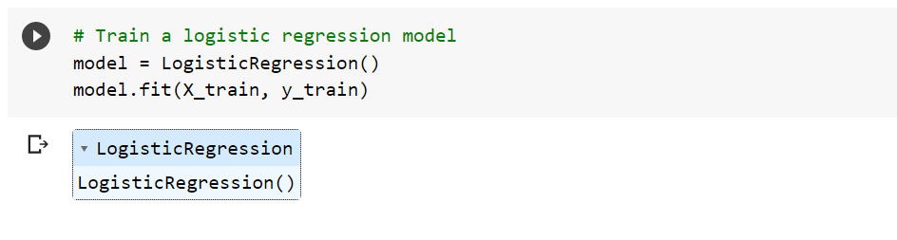
4. Train the Model

Slide 13
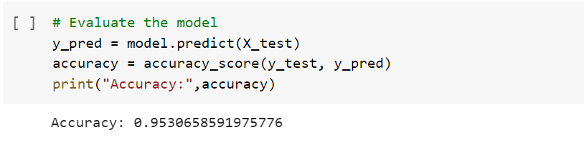
5. Evaluate the Model Accuracy

Slide 14
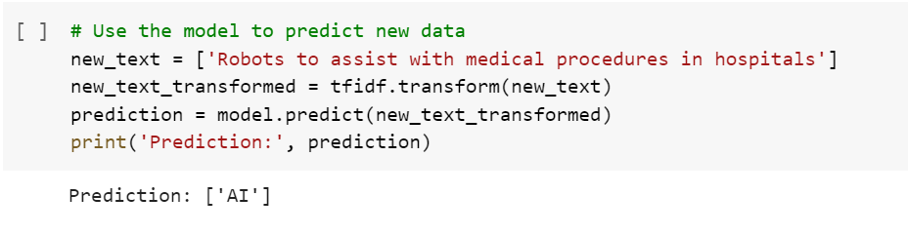
6. Use the model to predict new data

Slide 15
Part-2 : Fake news Detection-Code
Collection and Preprocessing of data
Performing Stemming using Porter Stemmer Algorithm
Conversion of textual data to numeric data using TF-IDF
Splitting the data into training and testing sets
Training and Evaluating model
Testing Data

Slide 16
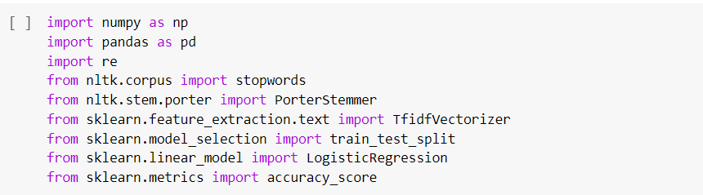
Collection and Preprocessing of data

Slide 17
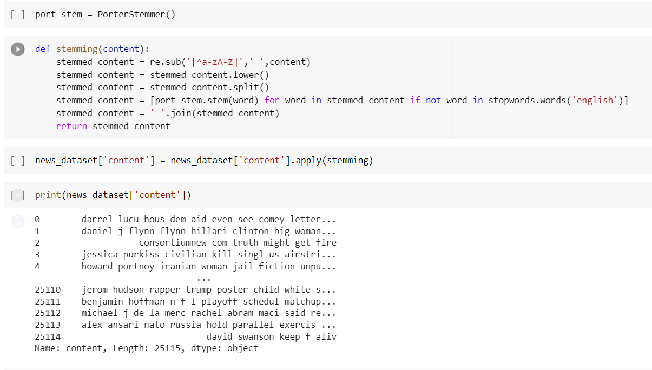
2. Performing Stemming using Porter Stemmer Algorithm

Slide 18
3. Conversion of textual data to numeric data using TF-IDF

Slide 19
4. Splitting the data into training and testing sets

Slide 20
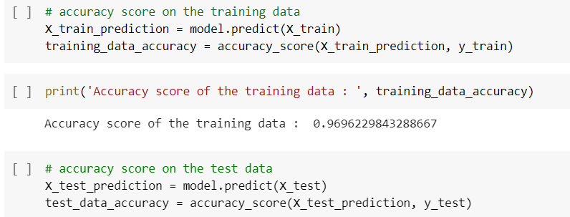
5. Training and Evaluating model

Slide 21
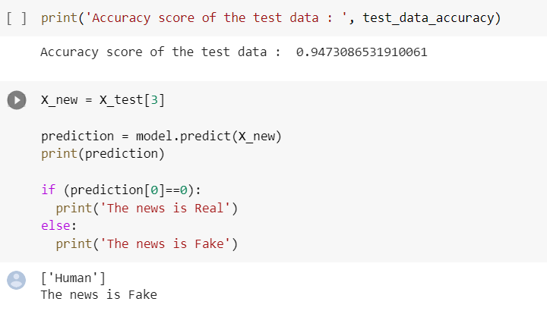
6. Training and Evaluating model

Slide 22
Conclusion
In our project we have identified and detected the fake news with the help of logistic regression.
logistic regression can be a useful technique for detecting fake news. By training a logistic regression model on a labeled dataset of real and fake news articles, the model can learn to identify patterns and features that distinguish the two types of articles. Once trained, the model can be used to classify new articles as either real or fake based on their features.

